Slide 1

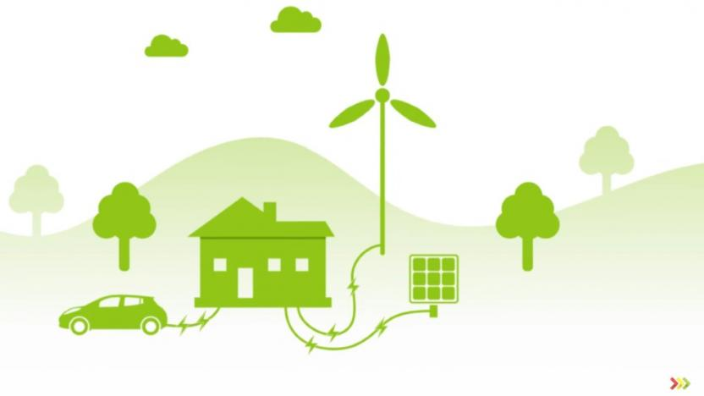

z
PROJECT 2
Green Energy Potential by U.S. State
UNC Bootcamp August 2019 Cohort
Team Members:
Nadire Gokcehan
Reid Powell
Jacob Abdelkhaleq

Slide 2
Data Sources
z
Data World: https://data.world/doe/united-states-renewable-energy
US Energy Information Administration: https://www.eia.gov/state/rankings/
Wikipedia: https://en.wikipedia.org/wiki/List_of_states_and_territories_of_the_United_States_by_population#cite_note-5
Kaggle: https://www.kaggle.com/washimahmed/usa-latlong-for-state-abbreviations
Leaflet: https://leafletjs.com/examples/choropleth/us-states.js
Our ETL Project Link for data cleaning process: https://github.com/nadireag/ETL-Project

Slide 3
z
What is Renewable Energy?
Renewable energy is energy that comes from natural resources such as sunlight, wind, rain, tides, plants, waves and geothermal heat. These energy resources are renewable, meaning they are naturally replenished.
The major types of renewable energy sources: Biomass, Hydropower, Geothermal, Wind and Solar.
Project Summary

Slide 4

z
Which states have the most potential renewable energy?
Total energy consumption vs. renewable energy potential by State: Can a State’s potential meet their consumption?
Types of renewable energy by highest potential: Which types account for the most potential? By State?
Questions to Answer

Slide 5
z
Clean and modify the data using Pandas and Jupyter Notebook.
Use Heroku and PostgreSQL as the database.
Use Python as the server-side language, Flask as the web server and SQLAlchemy as the ORM.
Use HTML, CSS and JavaScript on the front end.
Use D3, Plotly, Chart.js and Leaflet to visualize the data.
Data Wrangling

Slide 6
z
Green Energy App:
https://project2-green-energy.herokuapp.com/
Demo

Slide 7
z
QUESTIONS?

